Slide 1
Blood Bank Management System
Submitted in the partial fulfillment for the award of the degree of
BACHELOR OF ENGINEERING
IN
Cloud Computing
Submitted by:
Veer Pratap Singh
22bcc70057
Under the Supervision of:
Ankur Gupta
Department of AIT-CSE
DISCOVER . LEARN . EMPOWER

Slide 2
Outline
Introduction to Project
Problem Formulation
Objectives of the work
Methodology used
Results and Outputs
Conclusion
References

Slide 3
Introduction to Project
The Blood Bank Management System is to create an e-Information about the donor and organization that are related to donating the blood. Through this application any person who is interested in donating the blood can register himself in the same way if any organization wants to register itself with this site that can also register. Moreover if any general consumer wants to make request blood online he can also take the help of this site. Admin is the main authority who can do addition, deletion, and modification if required.

Slide 4


Slide 5
Problem Formulation
Existing System
No use of Web Services and Remote Apps.
Risk of mismanagement and of data in manual system.
Less Security.
No proper coordination between different Applications and Users.
Fewer Users – Friendly

Slide 6
Proposed Solution
The people in need of blood can search for the donors by giving their blood group and city name.
It is very flexible and user friendly.
The person’s time and work is reduced very much which prevails in the present system.
Easy and Helpful.
The people are not limited to receive or provide services in working hours of the branch only; he is serviced 24 hours a day, 7 days of week and 365 days of the year.

Slide 7
Objectives of the Work
1 Related Project 1: Hospital Management System
A Hospital Management System is an integrated information system for managing all aspects of a hospital's operations such as medical, financial, administrative, legal, and compliance. It includes electronic health records, business intelligence and revenue cycle management.
2 Related Project 2: Medical Store Management System Drug Store Management and Rational Drug. Drugs & Medicines being expensive and resources limited, it becomes imperative to improve their supply, increase the use, and minimize the cost through a pharmaceutical management system to be effectively put in place.

Slide 8
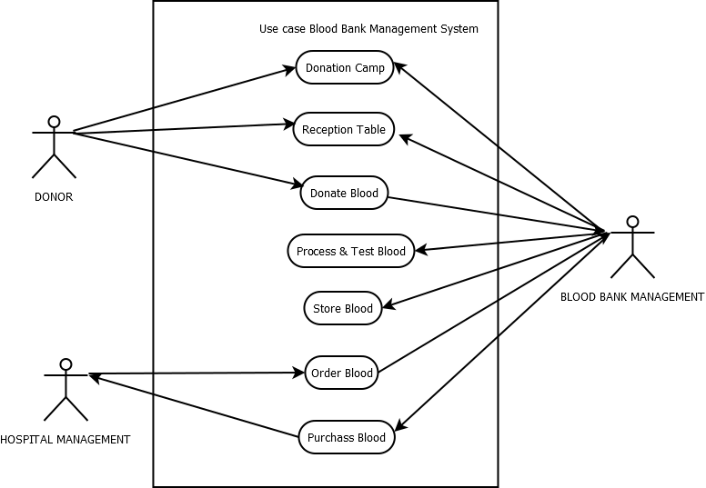
Design

Slide 9
Results and Outputs
During the software-testing phase each module of software is thoroughly tested for bugs and for accuracy of output. The system developed is very user-friendly and the detailed documentation is also given to the user as online help wherever necessary. The implementation phase normally ends with the formal test involving all the components.
The entire system was developed using the PHP, HTML, JavaScript, Personal Web Server, and MySql as back end. The HTML is used to design the web page. The Personal Web Server is used to understand the client’s request and to send response to them. The JavaScript, are used for client-side validations so that the user can enter only appropriate input in the input fields. The MySql is the back end tool where the database resides.
Hence the design of the entire system is user-friendly and simple the implementation has been quite easy.

Slide 10
Conclusion
This project has given us an ample opportunity to design, code, test and implements an application. This has helped in putting into practice of various Software Engineering principles and Database Management concepts like maintaining integrity and consistency of data. Further, this has helped me to learn more about MySql, PHP, HTML, JavaScript, Adobe Photoshop 7.0 .
I thank my guide for his invaluable contribution in guiding me throughout the project. I also thank my teacher and friends who have supported and motivated me to complete this project successfully.

Slide 11
References
Python documentation: https://docs.python.org/3/
Flask documentation: https://flask.palletsprojects.com/
SQLite documentation: https://www.sqlite.org/docs.html
GitHub repository for Flask: https://github.com/pallets/flask

